Slide 1




Data Visualization

Slide 2

Objective & Outline
Page 01

Slide 3

Objective & Outline
Objective
Understand what data visualization is and how important the data visualization process is for data analysis and modeling needs using the popular Matplotlib library.
Outline
What is Data Visualization?
Matplotlib
Visual Categories
Single, double and multiple variables visualization
Assignment 1
Page 02

Slide 4
What is Data Visualization?
Page 03

Slide 5

What is Data Visualization?
Data visualization is the discipline of trying to understand data by placing it in a visual context so that patterns, trends and correlations that might not otherwise be detected can be exposed.
Page 04

Slide 6
Matplotlib
Page 05

Slide 7

Matplotlib
Matplotlib is a comprehensive library for creating static, animated, and interactive visualizations in Python. Matplotlib makes easy things easy and hard things possible.
“A picture is worth a thousand words”
Page 06

Slide 8
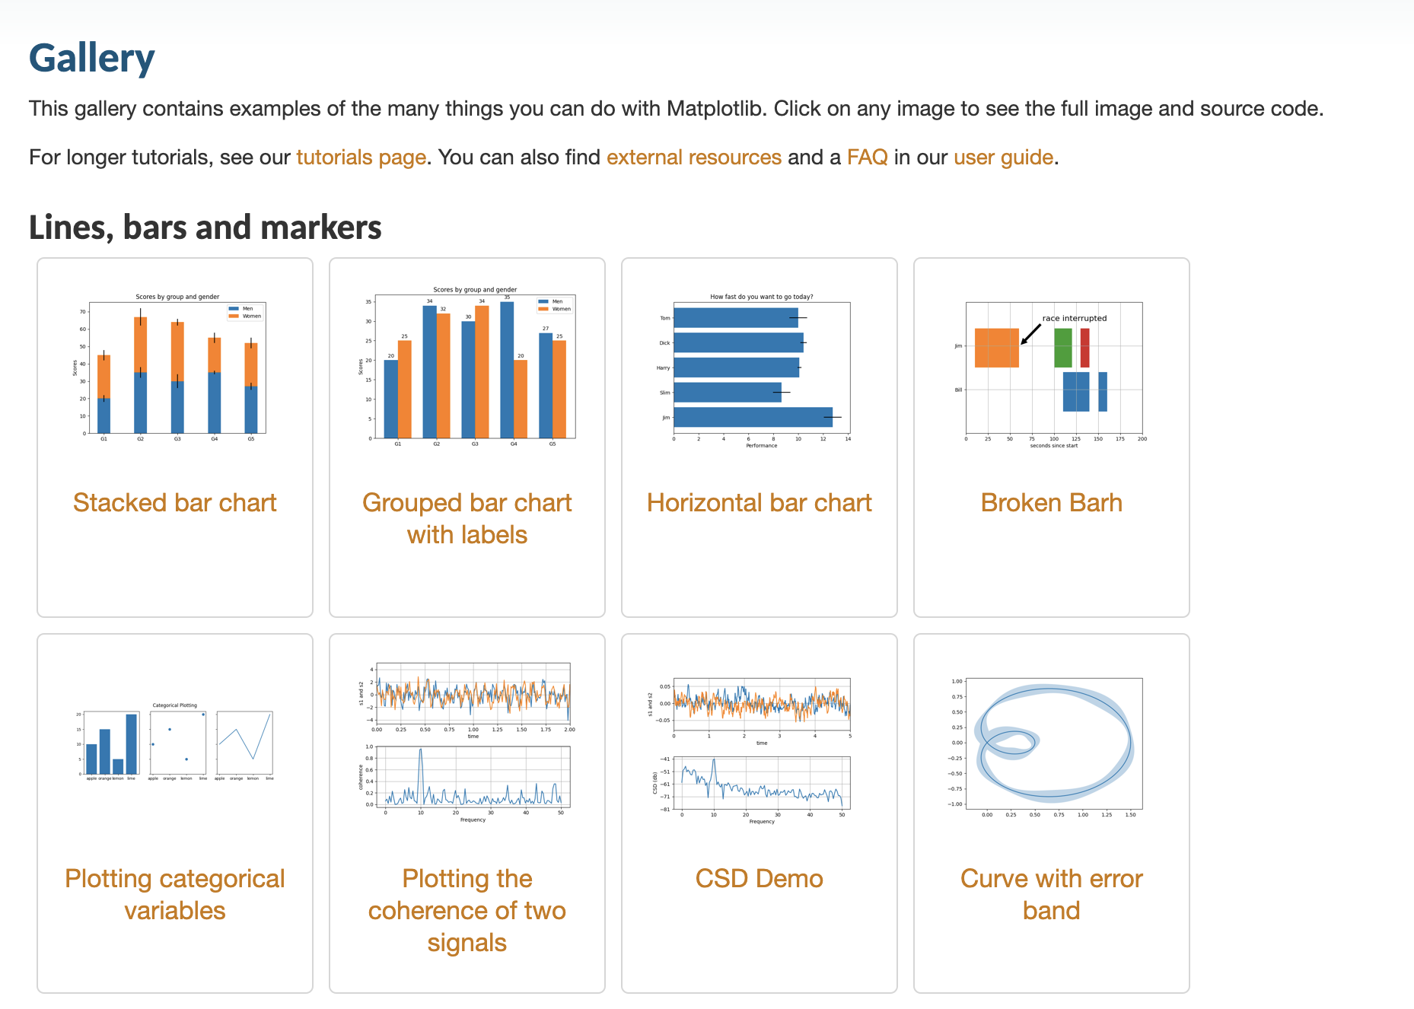
Matplotlib
Matplotlib Galery
https://matplotlib.org/stable/tutorials/index.html
Page 07

Slide 9
Visual Categories
Page 08

Slide 10
Visual Categories
We can divide the chart messages in four categories namely:
Distribution
Comparison
Relationship
Composition
Page 09

Slide 11
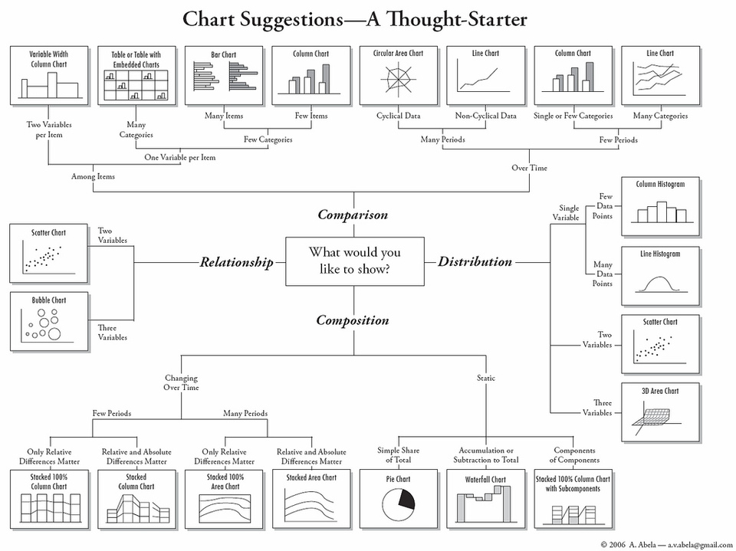
Visual Categories
Page 10

Slide 12
Single, Double, & Multiple Variable Visualization
Page 11

Slide 13

Visualization
We can also -if you want- divide the chart messages in three categories namely;
1. Single Variable Visualization
2. Two Variable Visualization
3. Multiple Variable Visualization
Page 12

Slide 14
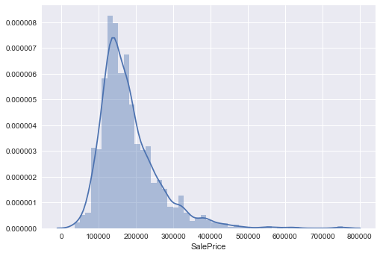
Single Variable - Displot
Summarize the distribution of a single variable dataset
Show centre, spread, skewness, outliers, multiple modes
Page 13

Slide 15
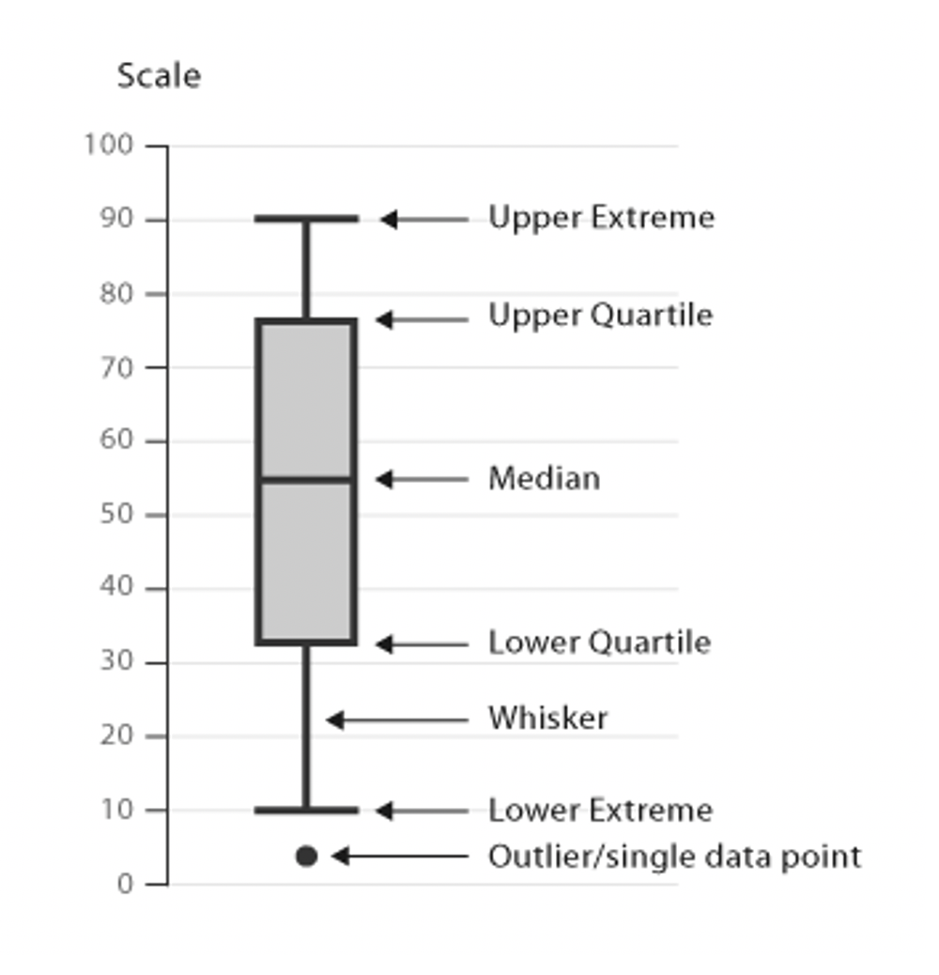
Single Variable - Boxplot
Depicting groups of numerical data through their quartiles
It shows a lot of information about a variable in one plot:
1. Median
2. Inter Quartile Range (IQR)
3. Outliers
4. Range
Page 14

Slide 16
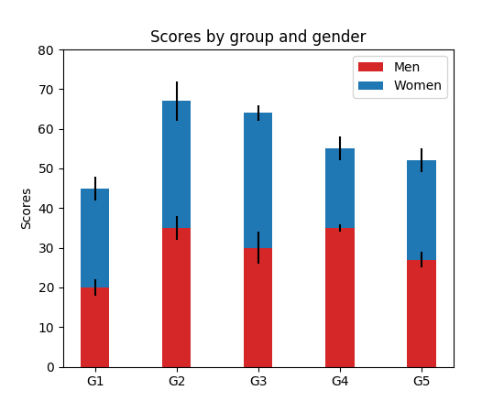
Two Variables - Stacked Bar Chart
Show comparisons between categories of data, but with ability to break down and compare parts of a whole
Page 15

Slide 17
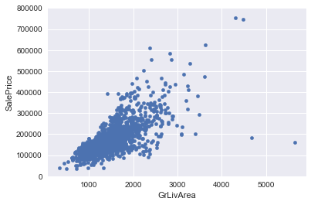
Two Variables - Scatter Plot
For two numeric variables
Use cartesian coordinates to display values for typically two variables for a set of data
This sample plot reveals a linear relationship between the two variables
Page 16

Slide 18
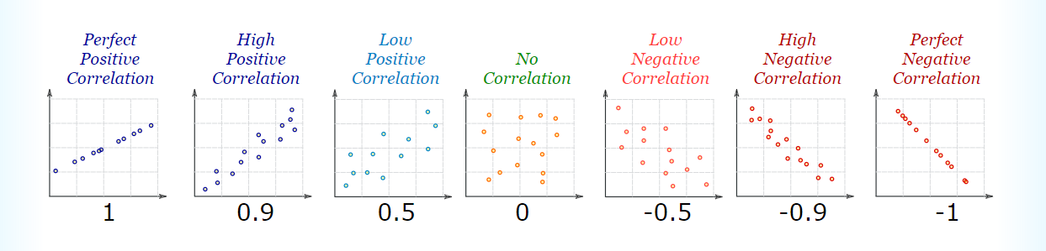
Two Variables - Scatter Plot
Page 17

Slide 19
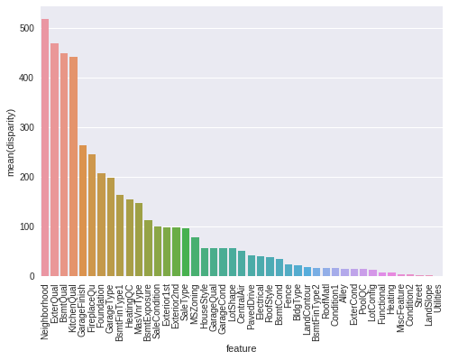
Multiple Variables - Scatter Plot
A bar chart or bar graph is a chart or graph that presents grouped data with rectangular bars with lengths proportional to the values that they represent
Page 18

Slide 20
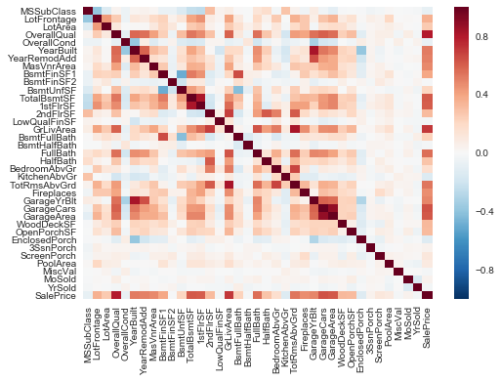
Multiple Variables - Heat Map
Graphical representation of data where the individual values contained in a matrix are represented as colours
Helpful to represent the correlation of data
Page 19

Slide 21
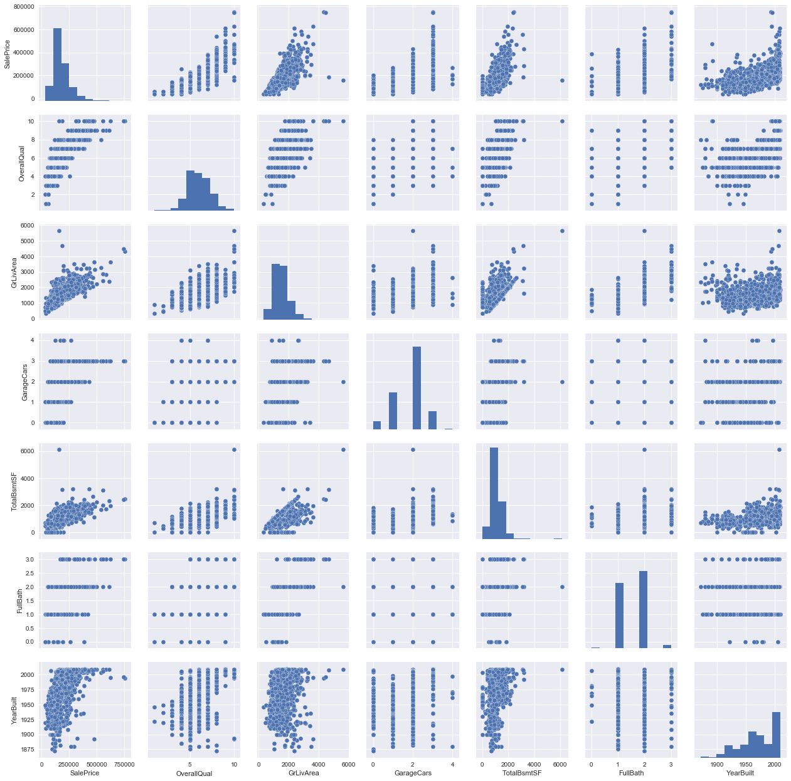
Multiple Variables - Pair Plot
Another useful seaborn plot is the pair plot which shows the bivariate relation
Show two across all feature combinations
Page 20

Slide 22
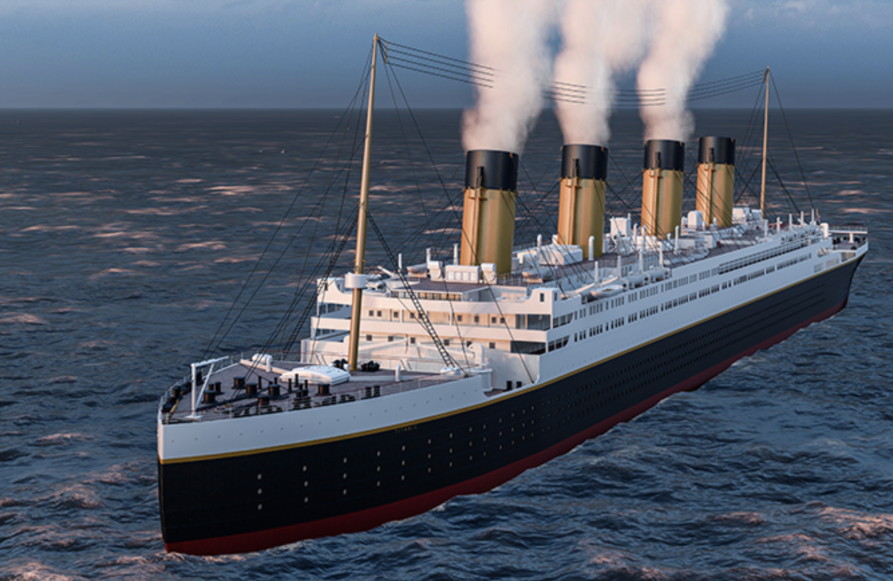
Assignment 1
Lakukan Data Visualization menggunakan datasets titanic.csv untuk menganalisa informasi Single Variable, Two Variable dan Multi Variable!
Akan dipilih dua mentee untuk mempresentasikan hasilnya pada pertemuan berikutnya!
Page 21

Slide 23
Terima Kasih!
Indonesia AI | AI for Everyone, AI for Indonesia
contact@aiforindonesia.org

